Slide 1
Software Engineering
Final Presentation
G7T8 - ~888~
Project Manager: Andy Ang
Members: Daniel Ang, Hani ‘Aiman, Hong Yuan, Xu Ying

Slide 2
Agenda
Schedule
Improvement from Progress Update
Breakdown of Work
Tasks & Bug Metrics
Use of GIT
Test Score
Server Information
Lesson Learnt

Slide 3
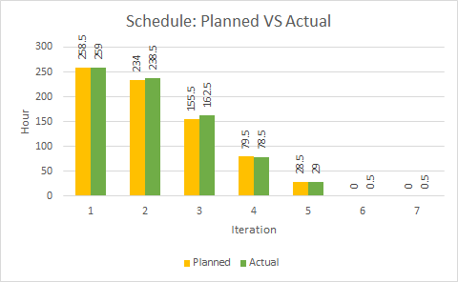
Schedule: Planned VS Actual
Notes:
Visual representation of Actual Versus Planned Schedule in 2 or less readable slides. A timeline representation is sufficient here.

Slide 4

Schedule: Actual VS Scheduled
4 Sep
17 Sep
18 Sep
1 Oct
2 Oct
15 Oct
Iteration 1
Iteration 2
Iteration 3
3 Oct
4 Oct
5 Oct
PM Review
Week 3 4 5 6 7 8 9
Planned Schedule
Planned
Actual Schedule
Actual
2 Buffer Days
Iteration 1
Iteration 2
Iteration 3
Notes:
Visual representation of Actual Versus Planned Schedule in 2 or less readable slides. A timeline representation is sufficient here.

Slide 5
Schedule: Actual VS Scheduled
16 Oct
29 Oct
30 Oct
12 Nov
13 Nov
23 Nov
Iteration 4
Iteration 5
Iteration 6
26 Oct
Application Demo
24 - 25 Oct
7 - 8 Nov
21 - 22 Oct
23 Nov
Final Presentation
Week 9 10 11 12 13 14
Planned Schedule
2 Buffer Days Used
Planned
9 Nov UAT
Actual Schedule
AGD Incomplete, push to Iteration 5
Actual
2 Buffer Days
Iteration 4
Iteration 5
Iteration 6
Notes:
Visual representation of Actual Versus Planned Schedule in 2 or less readable slides. A timeline representation is sufficient here.

Slide 6
Schedule: Functionalities & Architecture
NO functionalities were dropped
NO additional functionalities were added
NO Framework, but following MVC Architecture:
Model
View
Controller
Notes:
Did you drop any functionalities, implement any additional functionalities, and/or use any frameworks or external libraries? If so what.

Slide 7
Schedule: External Library
uploadbean.jar, struts.jar, fileupload.jar, cos.jar
Used for bootstrap function
Needed for uploading purpose
is203-jwt-v2.jar, json-smart-1.2.jar, nimbus-jose-jwt-2.26.1.jar
Used for JSON
For SharedSecretManager.java
opencsv-2.4.jar
Also for uploading purposes
To allow us to use CSVReader object
Notes:
Did you drop any functionalities, implement any additional functionalities, and/or use any frameworks or external libraries? If so what.

Slide 8
Schedule: External Library
mysql-connector-java-5.1.44-bin.jar
For JDBC
Allows us to connect to mysql database to extract/upload information from/to PhpMyAdmin
gson-2.8.1.jar
To convert JSON to GSON for pretty-printing
d3.floorplan.min.js, d3.v2.js
For generating Heatmap overlays
Jquery.min.js, bootstrap.js, bootstrap.css
For UI designs
Notes:
Did you drop any functionalities, implement any additional functionalities, and/or use any frameworks or external libraries? If so what.

Slide 9
Schedule: Lessons Learnt
Planning ahead is difficult - It is hard to predict the future and estimate the time taken for a task. But as the iterations goes by, we know what is needed to be done and plan accordingly before the start of the next iteration
Should not edit planned tasks during iteration - Previously we edited the schedule during the iteration. However, we learnt from our mistakes and started putting unplanned tasks (if any) from iteration 3 onwards
Conflict in schedule - Everyone is very busy so it may be difficult to meet up for pair programming or weekly meetings. Hence, we found a common timing and fixed Tuesdays & Fridays for either pair programming sessions or team meetings
Notes:
Tell us about the problems you faced tracking your schedule and how you overcame them.

Slide 10
Improvement from Progress Update
We have received two comments from Prof on Week 10:
We should use AWS link for our UAT and Final submission
Our pair programming hours should be equal
Notes:
Summarize the main comments you got from week 10 and show us how you improve your project management.

Slide 11
Improvement from Progress Update
Based on the comments we added more hours to the member whose pair programming hours is the lowest.
This is to ensure that everyone will have equal workload in terms of programming and non programming tasks
Notes:
Summarize the main comments you got from week 10 and show us how you improve your project management.

Slide 12
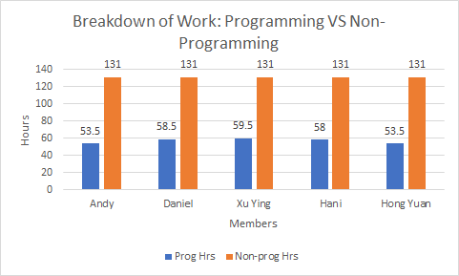
Breakdown of Work
Notes:
Separate the programming tasks from the non-programming tasks. For programming tasks, show us the task allocation as well as the hours spent by each team member.

Slide 13
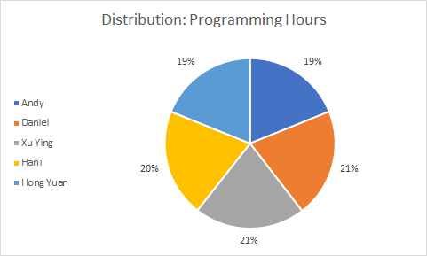
Breakdown of Work
Notes:
Explain why your work allocation was fair. Show us absolute numbers as well as percentages.

Slide 14
Fair Work Allocation
Our team has allocated work fairly because:
Everyone took the role as Project Manager
Generally equal PP & Non-PP hours for everyone
Task allocation are equal in terms of time and difficulty

Slide 15
Breakdown of Work
Iteration | Function | Andy | Daniel | Hani | Hong Yuan | Xu Ying
1 | Login |  | Y | Y | Y | Y
2 | Login | Y |  | Y | Y | Y
 | Breakdown | Y |  | Y | Y | Y
 | Top-K Popular Places | Y |  | Y | Y | Y
3 | Heatmap | Y |  | Y
 | Top-K Next Places | Y |  | Y
 | Top-K Companion | Y |  | Y
 | Bootstrap |  | Y |  | Y
Notes:
Separate the programming tasks from the non-programming tasks. For programming tasks, show us the task allocation as well as the hours spent by each team member.

Slide 16
Breakdown of Work
Iteration | Function | Andy | Daniel | Hani | Hong Yuan | Xu Ying
4 | AGD |  | Y |  |  | Y
 | JSON | Y |  |  | Y
5 | AGD |  |  | Y |  | Y
 | JSON (AGD) |  |  | Y |  | Y
Notes:
Separate the programming tasks from the non-programming tasks. For programming tasks, show us the task allocation as well as the hours spent by each team member.

Slide 17
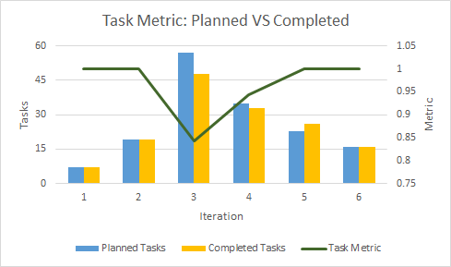
Task Metric
There were 9 holds/incomplete tasks during iteration 3
There were 2 holds/incomplete tasks during iteration 4
Notes:
Show us a visual representation of each metric that shows the values of each metric over time.
For iteration 3 → 9 holds/incomplete
For iteration 4 → 2 incomplete

Slide 18
Task Metric
Problems in Iteration 3:
We have 9 unplanned tasks since we underestimated the time required to finish the bootstrap, companion and top next K functions
Problems in Iteration 4:
We didn’t complete AGD function and had to push to next iteration since we underestimated the time required to finish the AGD function
Notes:
Tell us how you used the metrics to fix problems identified.
Give us examples of concrete follow-on actions you took to fix the most severe problems identified by these metrics.
What were some of the challenges faced (and how you overcame them) when collecting and using the metrics?

Slide 19
Task Metric
Mitigation Action for Iteration 3:
Our team re-estimated the tasks for future iterations
We deducted 2 days from our buffer days
Mitigation Action for Iteration 4:
Estimates were slowly getting on track
We did NOT deduct or add any buffer days
Notes:
Tell us how you used the metrics to fix problems identified.
Give us examples of concrete follow-on actions you took to fix the most severe problems identified by these metrics.
What were some of the challenges faced (and how you overcame them) when collecting and using the metrics?

Slide 20
Task Metric
Challenges faced when collecting metric:
Changes made on Planned Task was not reflected
Actions taken to overcome:
We manually calculated the metrics based on the formula given

Slide 21

Bug Metric
Current bug metric score:
We have solved all the bugs found in testing, using our planned debugging time in the iteration
Notes:
Tell us how you used the metrics to fix problems identified.
Give us examples of concrete follow-on actions you took to fix the most severe problems identified by these metrics.
What were some of the challenges faced (and how you overcame them) when collecting and using the metrics?

Slide 22
Bug Metric
Iteration | Bug Score | Mitigation Actions
1 | 1 | Fix during buffer time only.
2 | 12 | Stop current development and resolve the bug immediately. Project Manager reschedules the project.
3 | 11 | Stop current development and resolve the bug immediately. Project Manager reschedules the project.
4 | 11 | Stop current development and resolve the bug immediately. Project Manager reschedules the project.
5 | 20 | Stop current development and resolve the bug immediately. Project Manager reschedules the project.
6 | 0 | No actions taken.
Notes:
Tell us how you used the metrics to fix problems identified.
Give us examples of concrete follow-on actions you took to fix the most severe problems identified by these metrics.
What were some of the challenges faced (and how you overcame them) when collecting and using the metrics?

Slide 23
Bug Metric
Problems faced in Iteration 5:
We faced highest number of bugs (20) after UAT
How we fix:
We used the debugging sessions to fix the all the bugs
Notes:
Tell us how you used the metrics to fix problems identified.
Give us examples of concrete follow-on actions you took to fix the most severe problems identified by these metrics.
What were some of the challenges faced (and how you overcame them) when collecting and using the metrics?

Slide 24
Bug Metric
Challenges faced when collecting metric:
It is very hard to set an impact score to the bugs identified
Actions taken to overcome:
We discussed among ourselves to decide the score to set for each bug

Slide 25
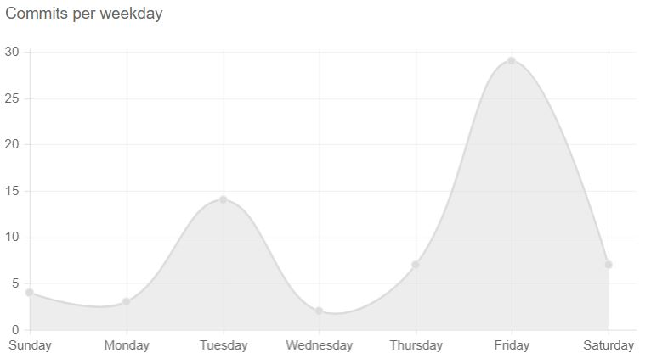
Use of GIT
Commits statistics from 15 September to 10 November:
67 commits during 63 days
Average 1.0 commits per day
Notes:
Demonstrate to us that you used GIT consistently, correctly, and evenly (across your entire team). You should use data (in nice graphical forms) from your commit logs, commit histories to substantiate your claims.

Slide 26
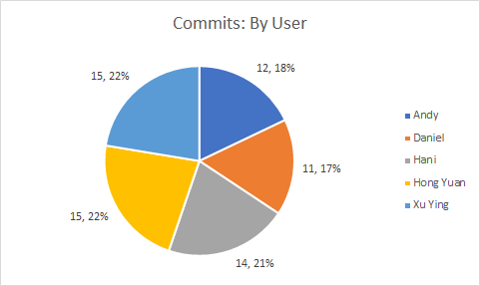
Use of GIT
Notes:
Demonstrate to us that you used GIT consistently, correctly, and evenly (across your entire team). You should use data (in nice graphical forms) from your commit logs, commit histories to substantiate your claims.

Slide 27
Test Score
We are expecting full marks from the rerun of manual and automated UAT JSON tests from elearn
Manual: 24/24
Automatic: 22/22
Notes:
Provide expected test scores if the manual and automated UAT JSON tests (that were released to you on elearn) are re-run after your final submission.

Slide 28
Server Information
Live Webapp:
http://13.59.132.127/app/index.jsp
Admin account:
User: admin
Password: Password!SE888
Notes:
Provide the IP address of your AWS server.
Provide your admin password (and also the admin page url if your app has a separate URL for the admin page).

Slide 29
Lesson Learnt
Equal work distributions is the key for our teamwork
It’s important to plan the schedule ahead and follow the schedule as team
Allow everyone voice out their opinions
Notes:
Tell us what are the main takeaways you have gained from doing the project?
Any team conflicts/issues/problems and how your team resolved it. Be sensitive. This is not a finger-pointing session.
Something particularly interesting about your team members that you did not know before SE.

Slide 30
Team conflict/issues/problems
Issue:
We had conflicts from different opinions on code logic
How we resolved:
We discussed in a group and found the optimal code logic for the functions
Notes:
Any team conflicts/issues/problems and how your team resolved it. Be sensitive. This is not a finger-pointing session.

Slide 31
Interesting facts about each member
Andy - Our music player during meetings
Daniel - Sleeps at weird timings
Hani - Always got sweets/snacks
Xu Ying - Very talkative and likes to speak in Chinese
Hong Yuan - Likes to eat food with very nice smell during meetings
Notes:
Something particularly interesting about your team members that you did not know before SE.

Slide 32
Thank you!
Q&A

